Slide 1


PY-EXPO
2K24
Team ID: T010
Team Name: CODE CRUSADERS
Genius innovation leaves behind a legacy...
PYEXPO 2K24

Slide 2
PS Code: PY23
Problem Statement: Multimodal Emotion Recognition in Sign Language
Multimodal emotion recognition in sign language is about understanding emotions expressed through hand gestures, facial expressions, and body language. By analyzing these different aspects together, technology can identify the emotions being conveyed, improving communication for sign language users.
02
PYEXPO 2K24

Slide 3
Solution
Developing a system for multimodal emotion recognition in sign language, several key steps are involved. Initially, data capturing entails recording sign language videos depicting various emotions utilizing a camera. Subsequently, the captured videos undergo processing, wherein to extract significant components like hand gestures and facial expressions. Through feature extraction, pivotal features such as hand movements and facial landmarks are identified from the videos. These features are then fused across different modalities, including hands, face, and body, to comprehensively understand the overall expression. Following this, machine learning models are trained on the extracted features to effectively recognize emotions. The implementation of real-time recognition algorithms enables instantaneous recognition of emotions as they are expressed. To facilitate user interaction, a user-friendly interface is developed to display the recognized emotions captured by the camera
Technology Stack
OpenCV
Facial Emotion Recognition
Hand Gesture Recognition
Machine Language
03
PYEXPO 2K24

Slide 4
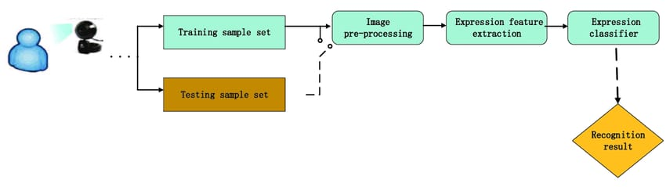
Emotion Recognition Flow Diagram
04
PYEXPO 2K24

Slide 5
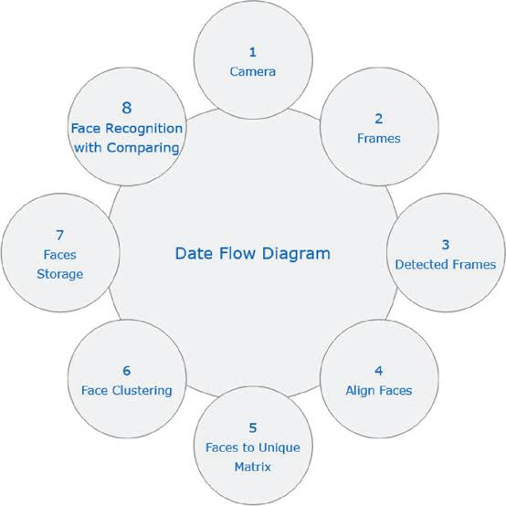
Face Recognition Flow Diagram :
05
PYEXPO 2K24

Slide 6
Team Member Details:
KAMALIKA . P - AI & DS (TL)
KANISHKA . C.U - AI & DS
KANISHKA . P - AI & DS
JAIYAKARTHI . S - AI & DS
DANUSH KUMAR . R - MECHANICAL
06

Slide 7
Thank You
PYEXPO 2K24

